Slide 1
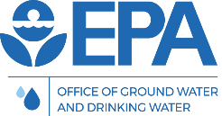
Working Session on American Iron and Steel (AIS) Requirements for the Clean Water and Drinking Water State Revolving Funds
WWEMA 109th Annual Meeting
“Finding Success in Uncertain Times”
Kiri Anderer, P.E.
U.S. EPA, DWSRF Team
November 9, 2017

Slide 2
Background – Authorization
ORIGINAL
In January 2014 Congress passed a bill with American Iron and Steel (AIS) requirements for State Revolving Fund (SRF) programs
  Consolidated Appropriations Act, 2014

Slide 3
Background – Authorization
CURRENT
Permanent for Clean Water SRF
  Water Resources Reform and Development Act (June 2014) amended Clean Water Act (section 608)
Year to Year for Drinking Water SRF
  Consolidated Appropriations Act, 2017
  Continuing Resolution until December 8, 2017

Slide 4
Background – What is AIS?
American Iron and Steel (AIS) provision requires SRF assistance recipients to use iron and steel products that are produced in the United States for the construction, alteration, maintenance, or repair of a public water system or treatment works
Listed products: lined or unlined pipes or fittings, manhole covers, hydrants, tanks, flanges, pipe clamps and restraints, valves, municipal castings, structural steel, reinforced precast concrete, construction materials

Slide 5
Background – What is AIS?
“Primarily” iron or steel means listed products must be made of greater than 50% iron or steel, measured by material cost
Produced in the U.S. means all manufacturing processes must take place in the U.S.
Permanently incorporated into the project

Slide 6
Background – Documenting Compliance
AIS certification letters required for all listed iron and steel products
  Step certifications, or
  Final manufacturer certifications
EPA recommends that SRF assistance recipients obtain AIS certification letters prior to installing products

Slide 7
Background – Documenting Compliance
AIS certification letters should:
  Be from manufacturers (can be from suppliers, but then they are taking risk)
  Be on company letterhead
  Contain the following FIVE things…

Slide 8
Example AIS Certification Letter
Project name/location
Specific items for project
Reference to AIS requirements
Where the items were manufactured
Signature
Bonus Points for Notary. Not required

Slide 9
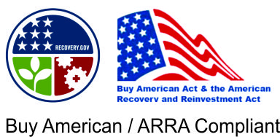
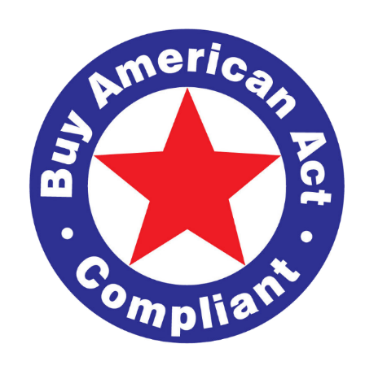
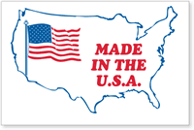
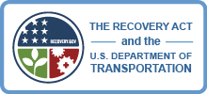
Do Other “Buy American” Letters
Work for the SRF AIS Requirement?
Short answer: No!

Slide 10
Background – Waiver Authority
Statute permits EPA to issue waivers for a case or category of cases where EPA finds:
  Applying these requirements would be inconsistent with public interest, OR
  Not produced in the U.S. in sufficient and reasonably available quantities and of a satisfactory quality, OR
  Increase cost of overall project by more than 25%

Slide 11
National Waivers
5 national waivers approved to date
  Plans and Specs
  De Minimis
  Minor Components in Iron and Steel Products
  Pig Iron and Direct Reduced Iron
  Short-Term Stainless Steel Nuts/Bolts Used in Pipe Restraint type products
    Expires February 18, 2018

Slide 12
Project/Product Specific Waivers
SRF assistance recipients may apply (through the state) for a project specific waiver, which applies to a particular product
Any other project funded by either the DWSRF or CWSRF that wishes to use the same product must apply for a separate waiver

Slide 13
Project/Product Specific Waivers
49 project specific waivers approved to date
  Examples of types of products:
    Large diameter butterfly valves
    Stainless steel products
    Well casings
    Ductile iron threaded flanges
    Insertion valves
    Specialty fittings
    Basket strainers

Slide 14
E.O. 13788
Buy American/American Iron and Steel is a high priority for the current administration
  Executive Order 13788 Buy American/Hire American signed April 2017
EPA’s implementation of the AIS provision is consistent with the E.O.
EPA has and will continue to conduct oversight through site visits and certification letter review

Slide 15
Discussion Questions
What are the successes of AIS? Has anyone expanded product lines? Constructed new facilities?
What are the challenges with AIS implementation?
Why are certain products not made in the U.S.?

Slide 16
Kiri Anderer, p.e. anderer.Kirsten@epa.gov
(202) 564-3134 srf_AIS@epa.gov http://www.epa.gov/cwsrf/state-revolving-fund-american-iron-and-steel-ais-requirement

