Slide 1
LIFT, an Innovation Ecosystem
WWEMA Water Week
March 22, 2017

Slide 2
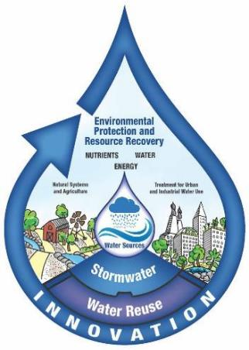
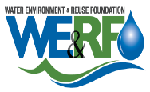


About WE&RF
WERF and WRRF merged in May 2016
WE&RF: Dedicated to research on re-NEW-able resources from wastewater, recycled water, and stormwater while maintaining the quality and reliability of water for the environment and communities.
New Focus: One Water.
WateReuse brings recycled water, desalination and related topics.
WERF brings wastewater, resource recovery, stormwater, receiving waters, climate change, and integrated water.

Slide 3
About WE&RF
501(c)(3) nonprofit located in Alexandria, VA
1989 – 2016: Research portfolio
>$200 million on water, wastewater, recycled water, and stormwater
Research organization
>350 subscribers
Partners: U.S. EPA, Department of Energy, National Science Foundation, Bureau of Reclamation, CA State Water Board, NYSERDA
30 staff members (over half manage research)
Broad focus on integrated water research
Notes:
WERF was Founded in 1989 and Water Reuse Research Foundation in 1990.
The new not-for-profit powerhouse, called the Water Environment & Reuse Foundation (WE&RF), brings together a rich portfolio of research in water, wastewater, and stormwater, valued at more than $200 million.
The merger strengthens the industry movement toward One Water, which realizes the true value of water, wastewater, and stormwater.
We are seeking to identify, support, and disseminate research that enhances the quality and reliability of water for natural systems and communities with an integrated approach to resource recovery and reuse, while facilitating interaction among practitioners, educators, researchers, decision makers, and the public.

Slide 4
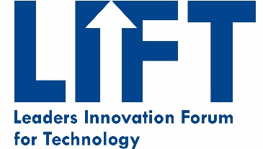
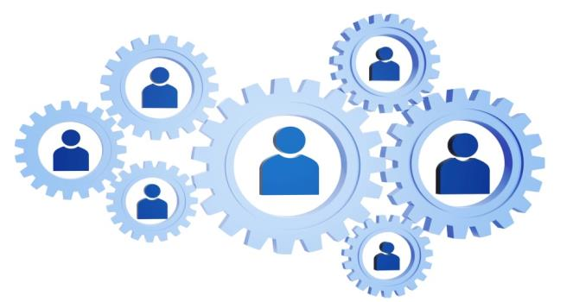
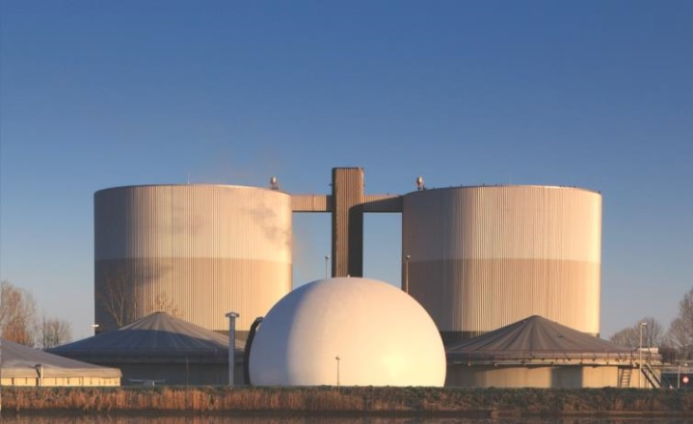
LIFT
LIFT is a WEF/WE&RF initiative to encourage and support innovation in water

Slide 5
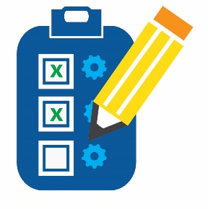


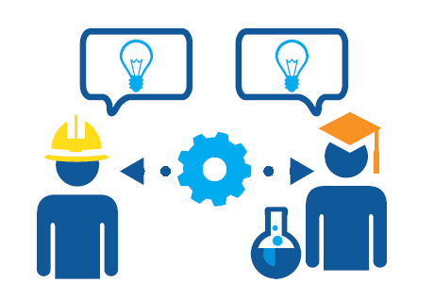
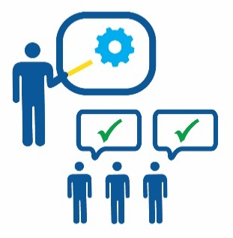
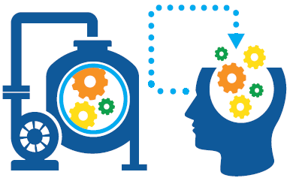

LIFT 101
Technology Scans | LIFT Link | FAST Water Network
SEE IT | University-Utility Partnership | Info Sharing and Collaboration | MA Toolbox
Notes:
SEE IT Scholarships
LIFT Link
Technology Scans
Forums to Present and Discuss/ Focus Groups
Academic Utility Connection
MA Toolbox
Test Bed Network

Slide 6
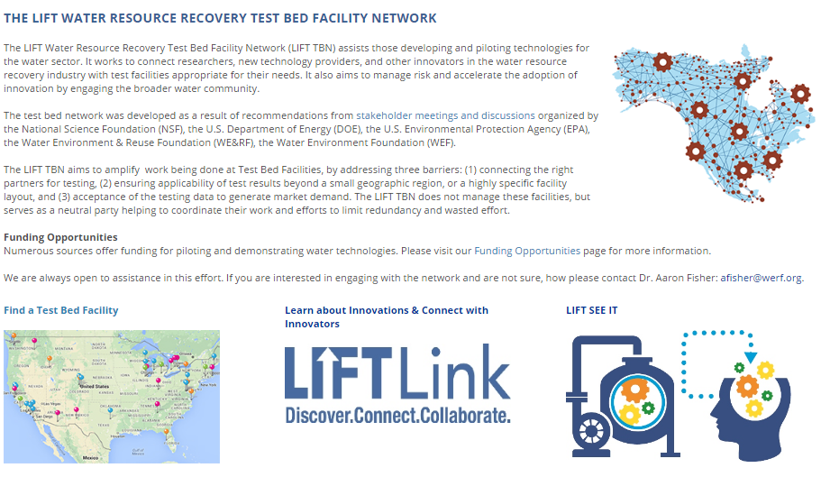

FAST Water Network
www.werf.org/testbednetwork

Slide 7




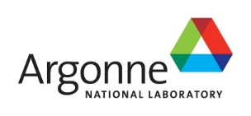

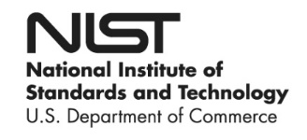

FAST Water Network
Steering Committee
Planning Partners

Slide 8




FAST Water Activities
guidance matchmaking validation data library
Notes:
Matchmaking
Data Validation
Data Library
Pilot Testing Guidance

Slide 9
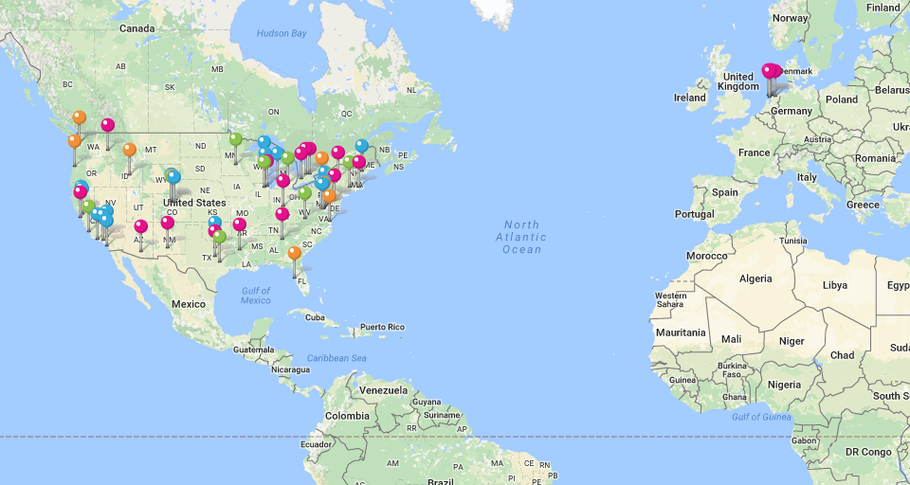
FAST Water Directory
Level 1
Level 2
Level 3
Level 4
70 Facilities
www.werf.org/testbeddirectory

Slide 10
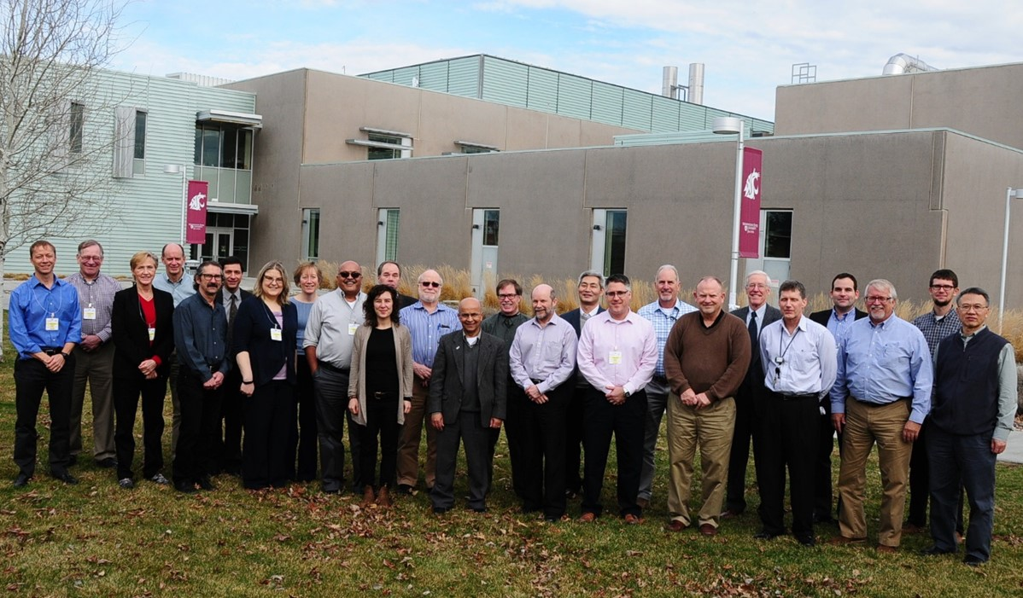
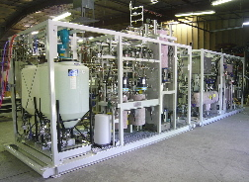
Example Collaboration –
Hydrothermal Processing Technology

Slide 11
Example Collaboration –
Hydrothermal Processing Technology
Phase 0- $230k
  proof-of-concept at PNNL
  10 utilities
Phase 1- $2.5M (50/50 DOE cost-share)
  validation, planning, and FEED (front-end engineering and design)
  18 utilities, 1 refinery, 1 utility
Phase 2 (planned)- $15M (50/50 DOE cost-share)
  construction and piloting of a 3 dry ton/day facility at Central Contra Costa (CA)

Slide 12





Technology Scans
Looking for innovative technologies that bring:
Expert panel of consultants, operators, regulators, and academics provides feedback on these criteria
Notes:
Value (money, performance, environment), Advancement, Chance of Success
If you are interested In joining please come up to me after.
70% that apply have been accepted

Slide 13
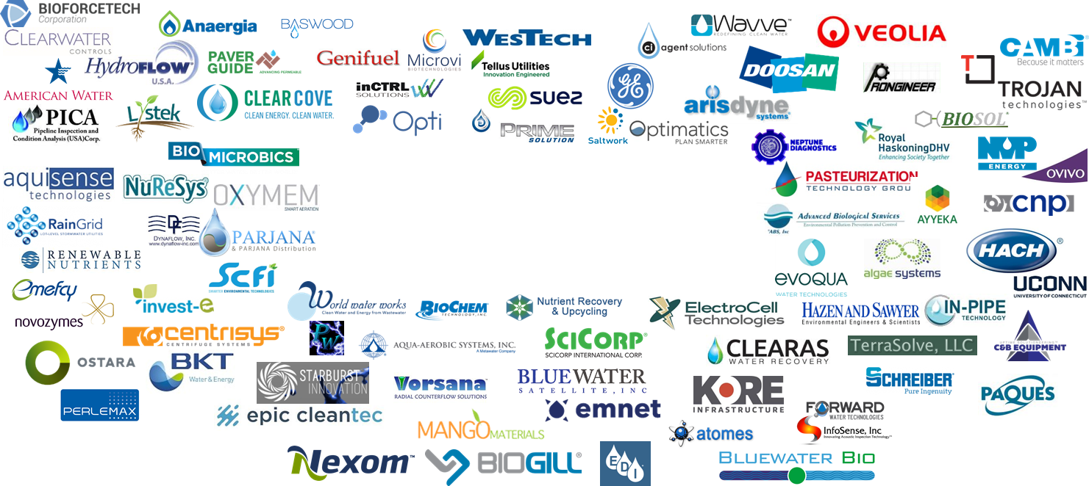
105 Technologies
97 Companies
Notes:
Hydrotorr Systems

Slide 14


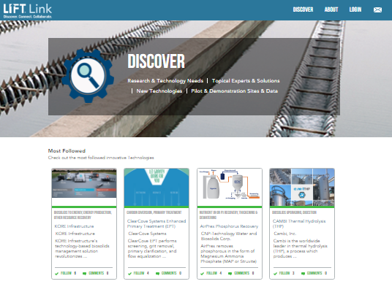
LIFT Link
http://liftlink.werf.org
Discover
Collaborate
Connect

Slide 15
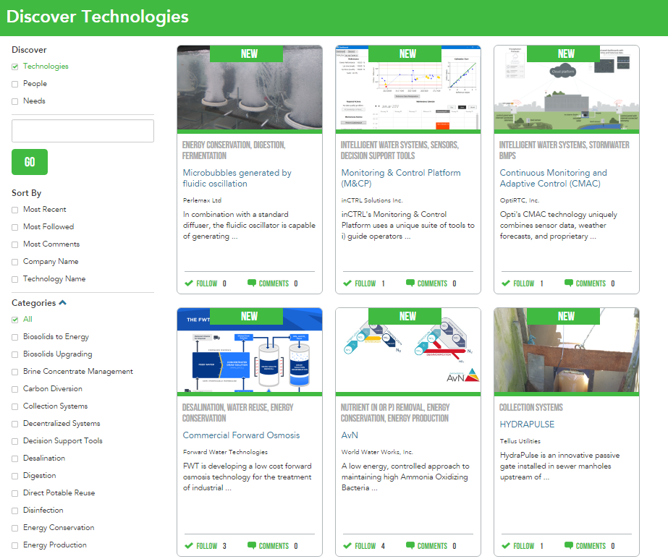
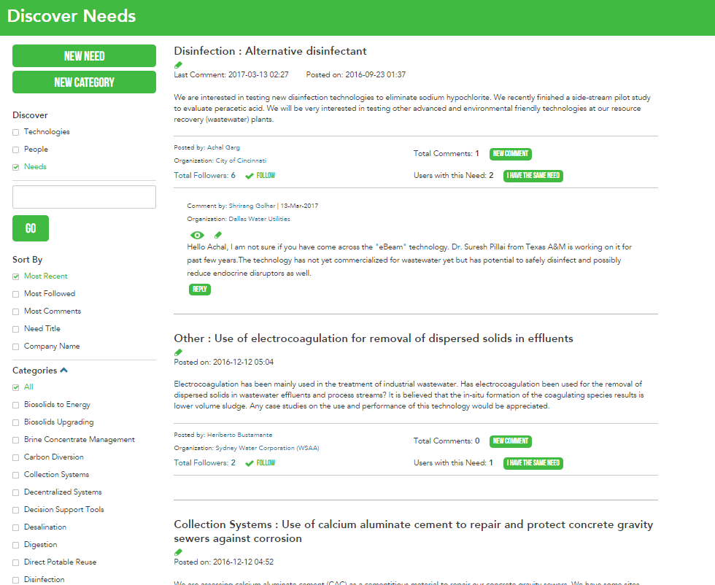
Discover Innovation
Discover Technologies
Discover Needs

Slide 16
LIFT SEE IT
Scholarship Exchange Experience for Innovation and Technology
WEF, NACWA, WE&RF Partnership
$30,000 in Travel Scholarship Funds
11 utilities awarded

Slide 17

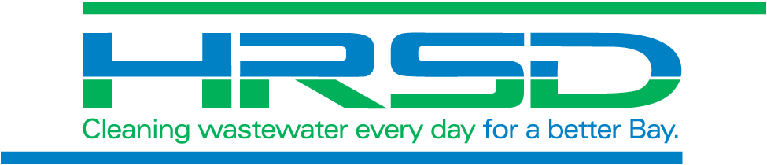
LIFT SEE IT
Recipient Spotlight: Washoe County Community Services visiting HRSD
Technology: Ozone-biological activated carbon and advanced oxidation (ultra-violet), membrane-based treatment systems, soil aquifer treatment processes and expertise to achieve potable reuse

Slide 18
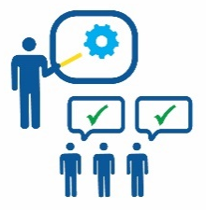
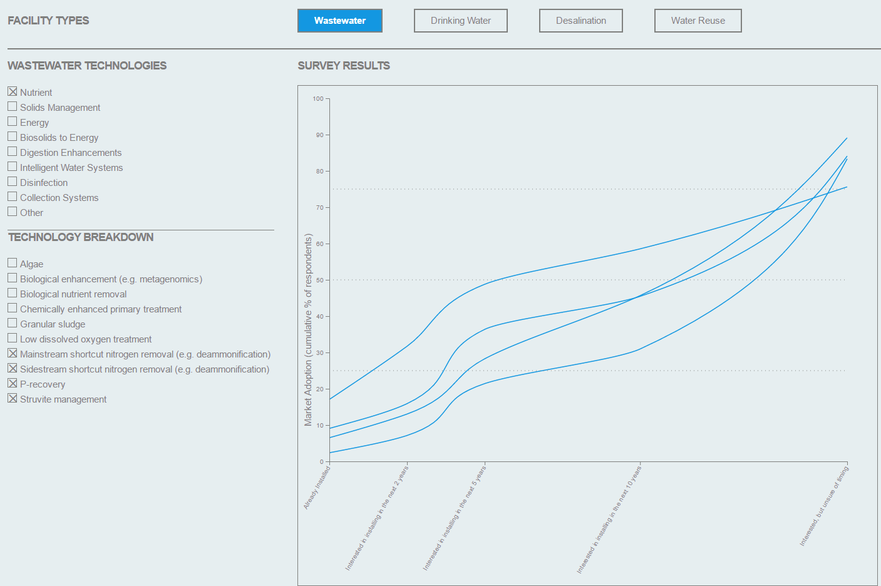
2017 Water Technology Survey
Deeper understanding of industry direction and peer’s activities
90 responses received to date regarding 100+ types of technology
Visualization to be publically available early Spring 2017

Slide 20
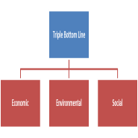
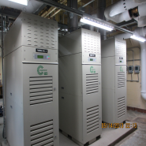
Research to Net Energy Neutral
A GUIDE TO NET-ZERO ENERGY SOLUTIONS FOR WATER RESOURCE RECOVERY FACILITIES
TRIPLE-BOTTOM LINE EVALUATION OF BIOSOLIDS MANAGEMENT OPTIONS
DEMONSTRATED ENERGY NEUTRALITY LEADERSHIP: a study of five champions of change

Slide 21
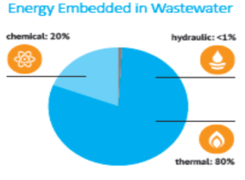
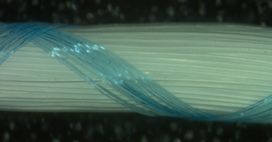
Net-Zero Research Findings/Needs
Potential for Heat Recovery from Wastewater
  State of the Science of Heat Recovery (ENER10C13)
Advance Low Energy Treatment Processes
  Advance Anaerobic Membrane Bioreactors as Low Energy Alternatives to Activated Sludge, coupled with short cut nitrogen processes (ENER4R12)
  Bench-Pilot Studies of Membrane Aerated Biofilm Reactors (MABRs) for Energy Efficient Wastewater Treatment (U2R14)
Develop Technologies to Recovery Energy in Biosolids
  Energy Recovery from Thermal Oxidation of Wastewater Solids: State of the Science Review (ENER13T14)
  Genifuel Hydrothermal Processing Bench Scale Technology Evaluation LIFT6T14
Notes:
From ENER1 report findings, area with research needs that we are addressing.

Slide 22
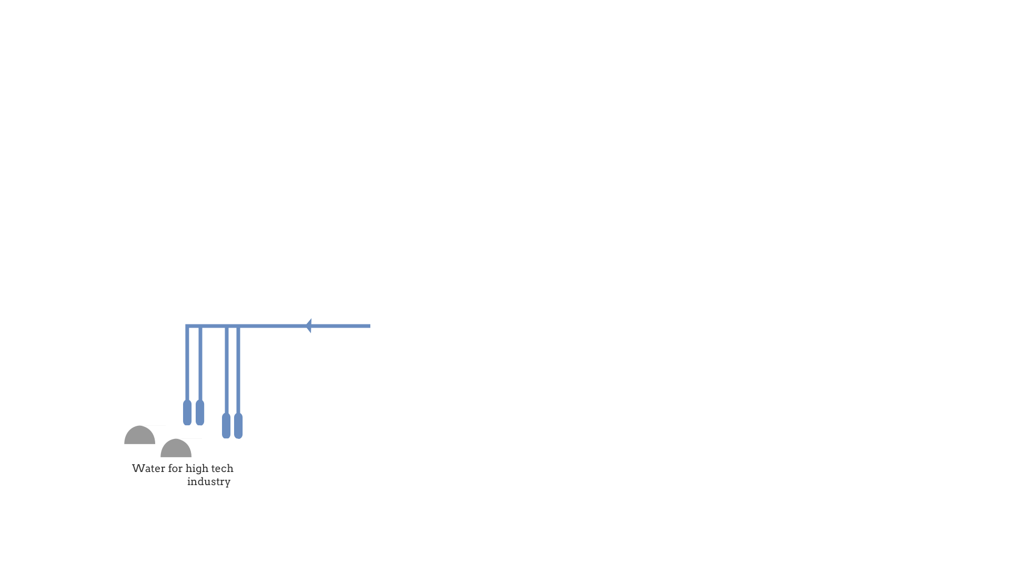
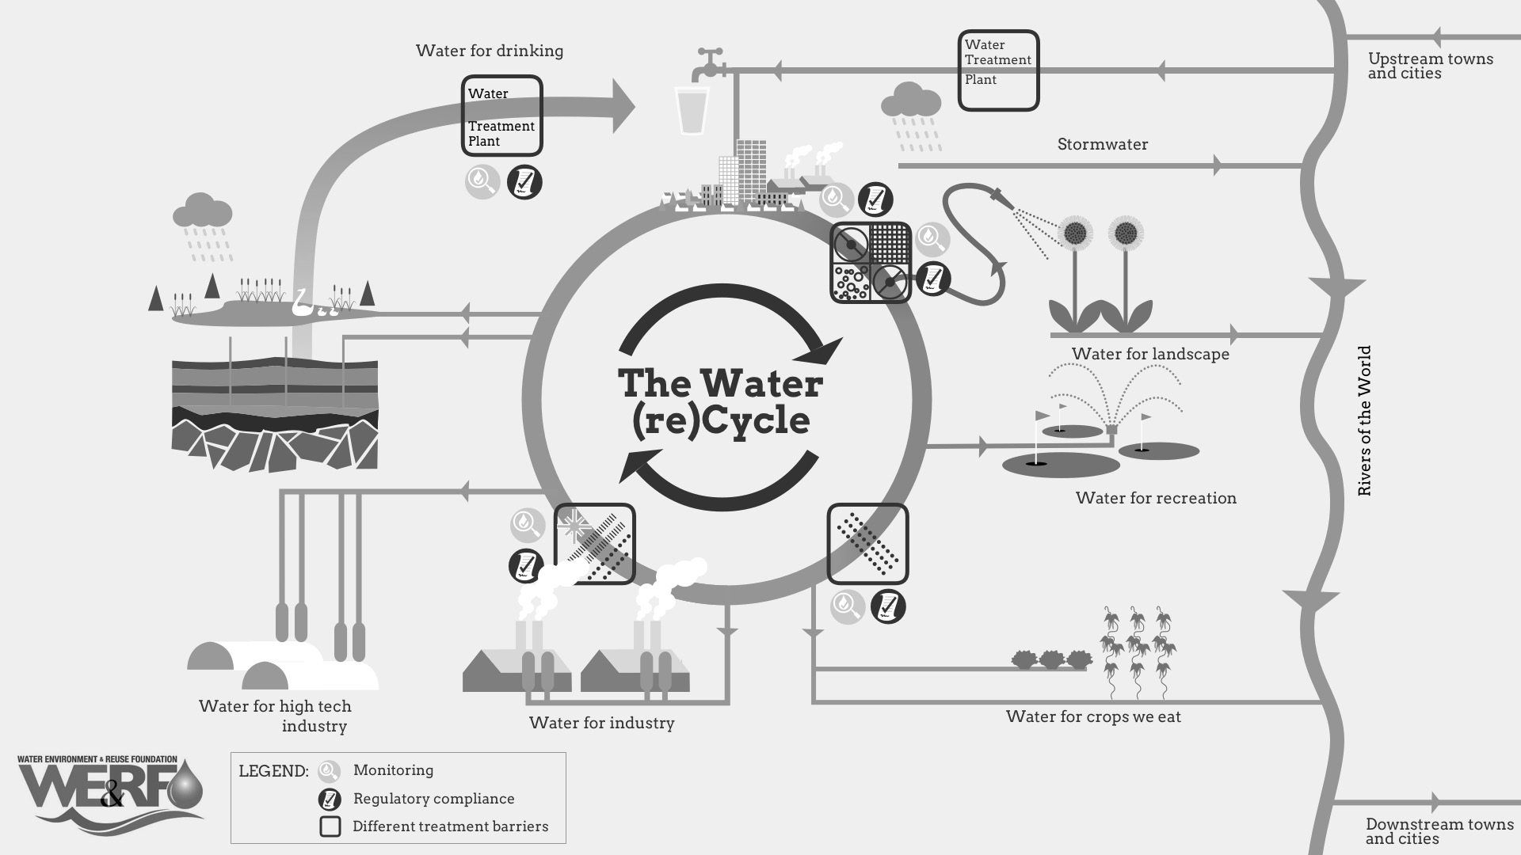
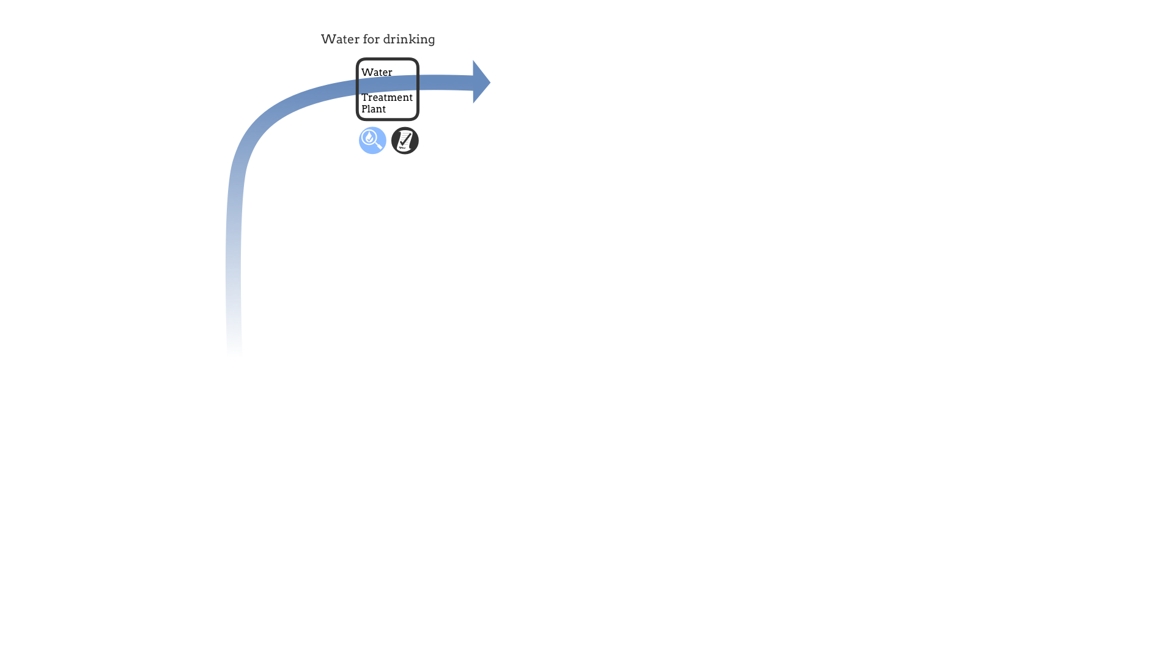
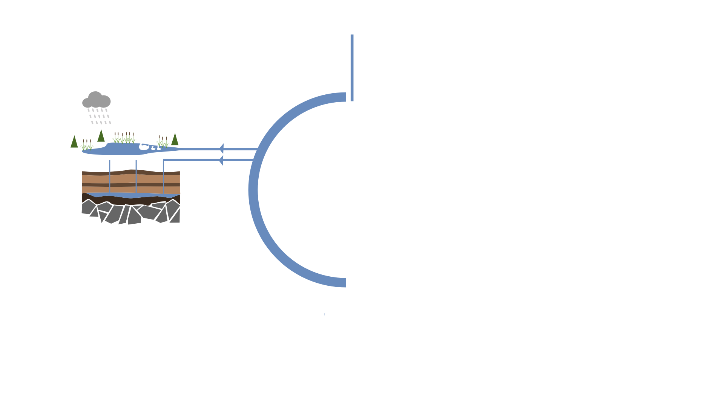
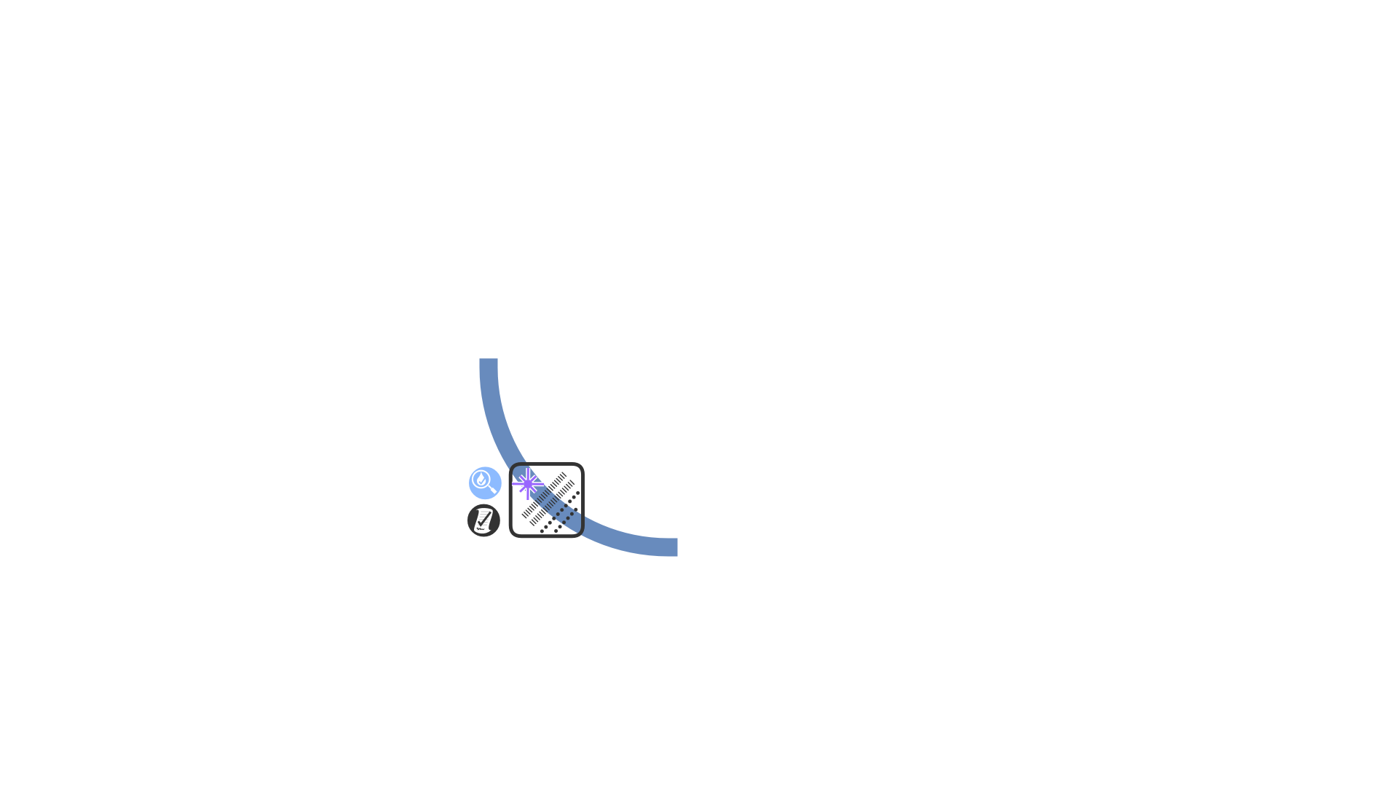
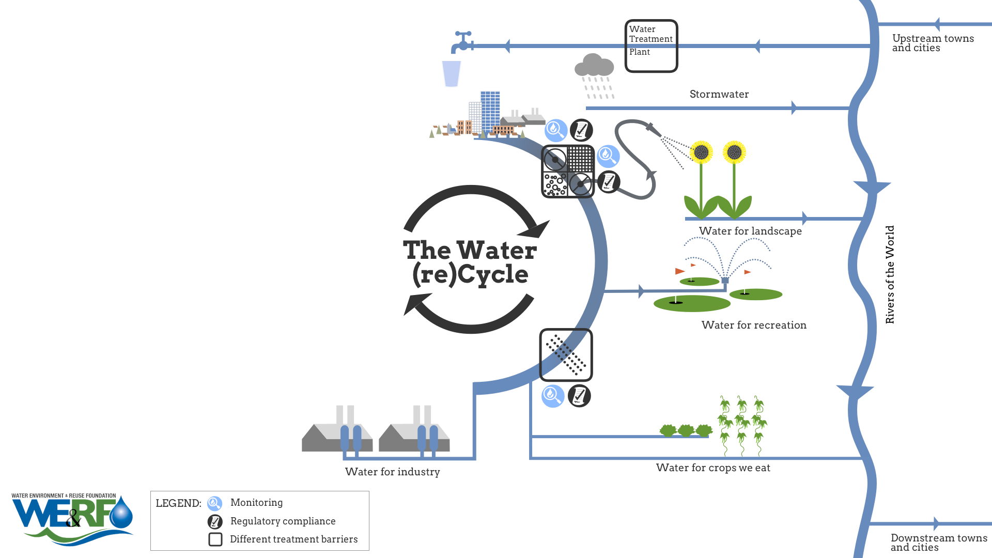
Notes:
This water is now available for drinking water supply. It has been treated and monitored to ensure that it complies with regulations and is safe for drinking.

Slide 23
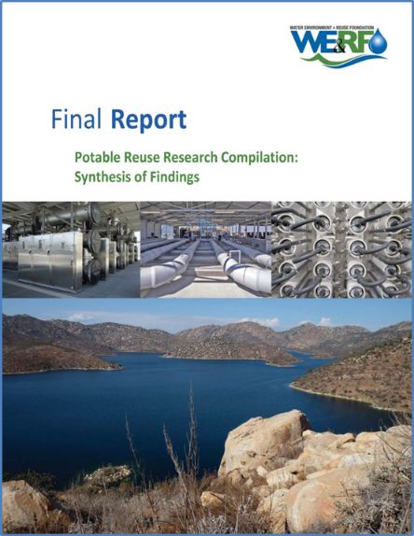
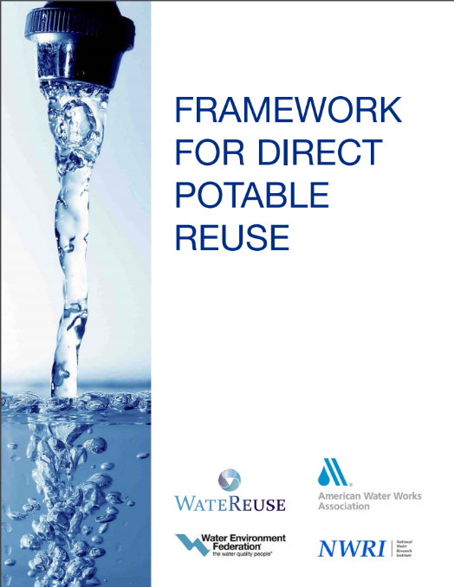
WE&RF DPR Research Initiative
California SB 918 (2010)
  “Feasibility of developing criteria for DPR”
  Established DPR Expert Panel
Initiative
  $6 million raised to the need to fill knowledge gaps
  Leveraged to $24 million
Funded 34 projects on topics
  Reliability of treatment trains
  Microbial and chemical water quality
  Monitoring and operations
  Public engagement
Notes:
WRRF+WRCA to provide research to be able to answer is it “feasible to develop criteria for DPR”?

Slide 24
Thank You
Aaron Fisher, afisher@werf.org
www.werf.org/lift

