Slide 1
Tools and Resources to Get Your Products into International Markets
Jorge Arce
Director (Jacksonville, Tallahassee, Pensacola)
U.S. Commercial Service
U.S. Department of Commerce

Slide 2

Let Us Help You Export
The U.S. Commercial Service is the lead trade promotion agency of the U.S. government. U.S. Commercial Service trade professionals in over 100 U.S. cities and more than 75 countries help U.S. companies get started in exporting or increase sales to new global markets. To find a U.S. office near you, visit http://export.gov/usoffices

Slide 3
We Open Doors No One Else Can
Global network of trade professionals
Business relationships with foreign governments, buyers, and business leaders worldwide
Notes:
• There’s always a U.S. Commercial Service close to where you are. Assistance is just a phone call, email, or visit away.
• U.S. Commercial Service trade counseling is customized, extensive, and focused on the needs of your company—no cookie-cutter approach.
• Once you connect with your local U.S. Commercial Service office, our worldwide network of trade professionals is at your disposal.
• Through relationships with foreign governments, buyers, and business leaders, we connect you with best prospects for your business. There’s a U.S. Commercial Service presence in 90 percent of U.S. export markets.
• We offer unparalleled industry and market expertise and assistance that addresses the unique exporting challenges of your industry.
• Every year, we help U.S. companies like yours export goods and services worth billions of dollars.

Slide 4

Doing Business Internationally Just Got Easier
Market Intelligence
Customized Trade Counseling
Business Matchmaking
Commercial Diplomacy and Trade Dispute Assistance
Notes:
Making your first sale? Entering new markets? We have the expertise you need to tap into lucrative opportunities and increase your bottom line.
• Market Intelligence. Easy-to-use resources help you explore the best trade opportunities.
• Trade Counseling. Trade professionals at an office near you can provide customized assistance to help you export successfully.
• Business Matchmaking. Expert advice is always available on the best ways to connect with promising buyers and partners.
• Commercial Diplomacy/Trade Dispute Assistance. We connect you with the help you need in-country, on the ground.

Slide 5
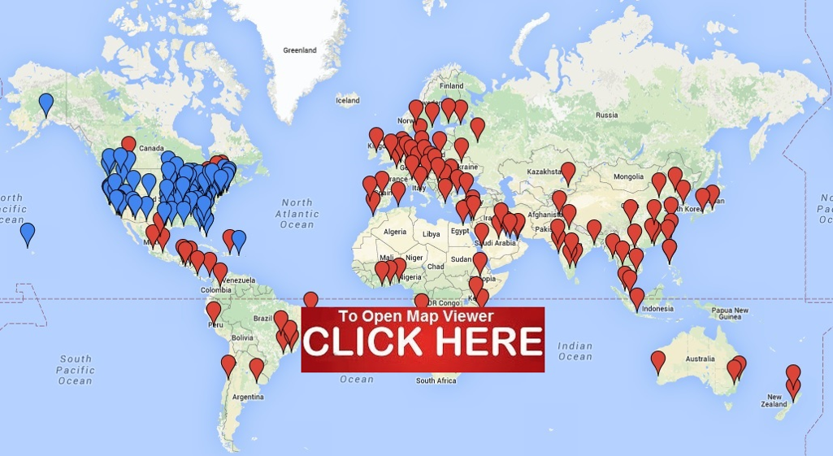
Local Expertise; Worldwide Reach
Notes:
108 U.S. Commercial Service offices around the country are staffed by experienced trade professionals, who can provide customized trade assistance to help you:
• Make sense of market intelligence resources;
• Find effective export techniques and trade financing;
• Develop an export plan and market entry strategies;
• Evaluate potential international partners;
• Navigate trade documentation and regulation challenges;
• Understand the legal aspects of trade;
• Find trade financing;
• Connect with qualified buyers and partners, through domestic and international trade events and other matching services.

Slide 6

Industry Expertise: ETechnologies
Teams of trade professionals worldwide serving exporters with innovative solutions and targeted information to meet their demand for relevant, timely, industry- and country-specific intelligence.
http://2016.export.gov/industry/environment/index.asp
Notes:
Our experienced trade professionals help you enter international markets in the most efficient, targeted way. We assess your export potential, understand your needs, and provide the right mix of export resources to achieve your goals.

Slide 7
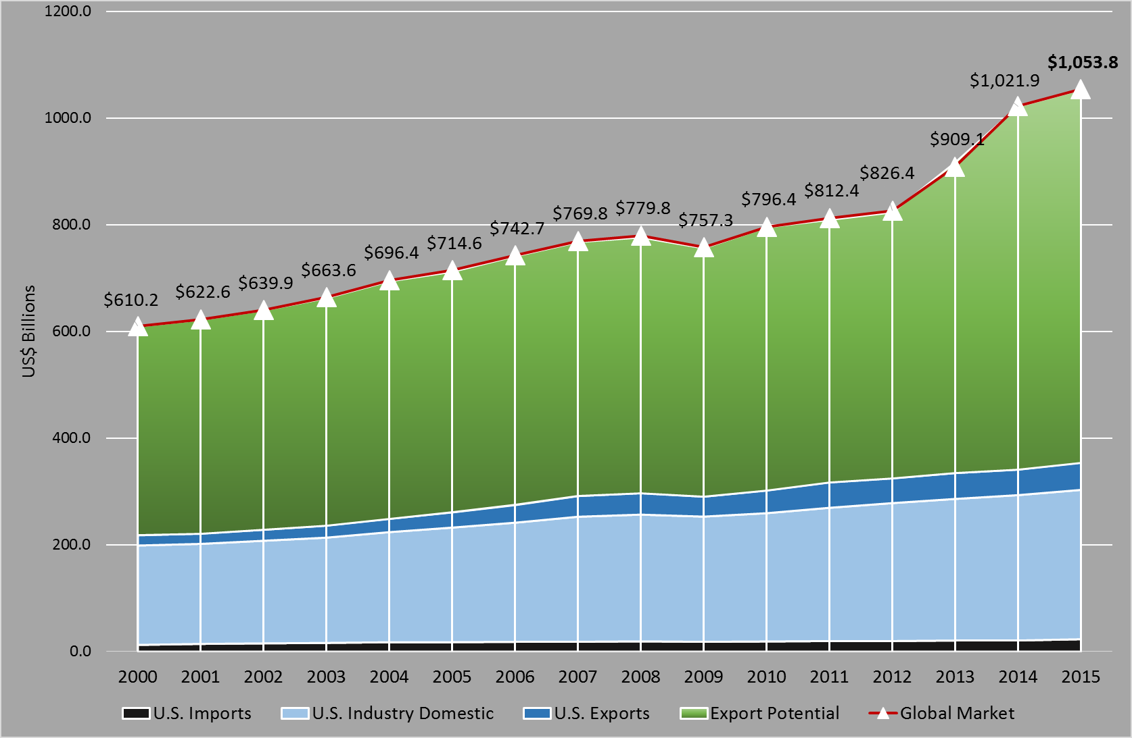
The U.S. ET Export Imperative, U.S. Billion
Export
Potential:
$699.6 Billion
Non-U.S.
Global Market
Current Exports:
$51.2 Billion
U.S. Industry Share
of Domestic
Market:
$279.9 Billion
U.S. Imports:
$23.1 Billion

Slide 8
Key Challenges and Opportunities Identified
CHALLENGES
OPPORTUNITIES
Preferential Procurement
Differential Standards & Regulatory Models
Availability of Finance
Government Support for Foreign Competitors
Low Technical Sophistication
Unprecedented Growth
Regulatory & Standard Development
Quality & Sophistication of U.S. Products and Services
Recognition of U.S. Brand & Reputation
MARKET
Industry Specific Data Gaps
Diffuse Number of Programs
Diminishing Resources
Interagency Coordination
Differential Missions
Marketing & Communication
EPA Shift Towards Export Promotion
Web-based & New Media Tools
Partnerships with Key Industry Players
NEI Platform
GOVERNMENT

Slide 9
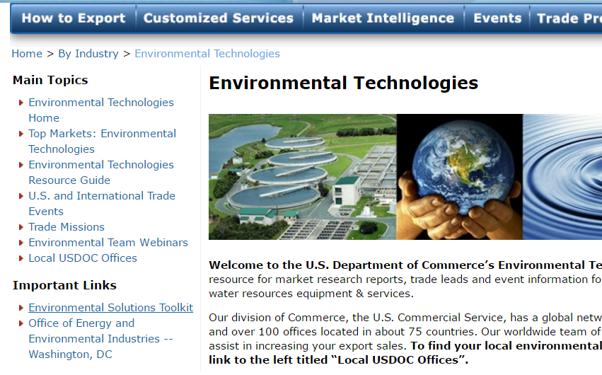
Environmental Technologies Team
http://2016.export.gov/industry/environment/index.asp

Slide 10
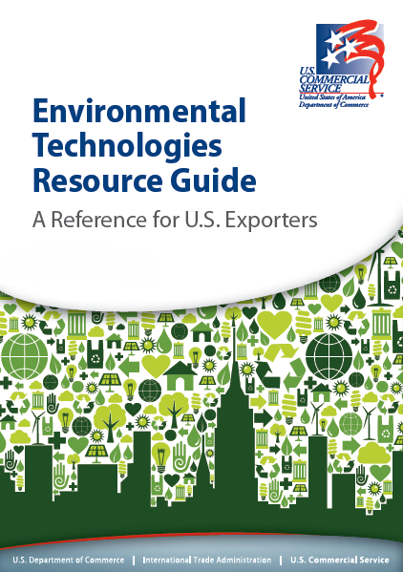
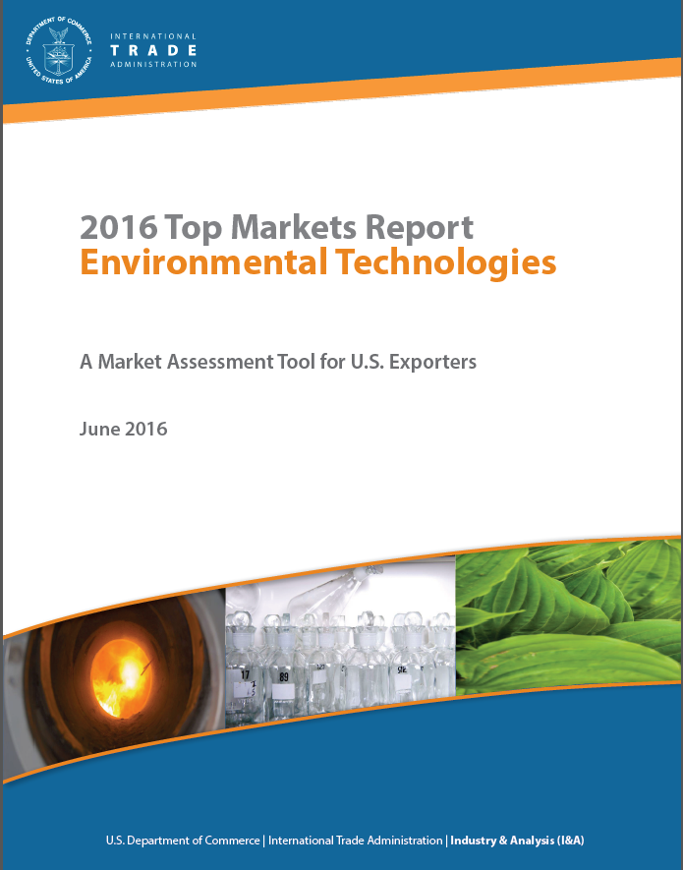
Publications

Slide 11
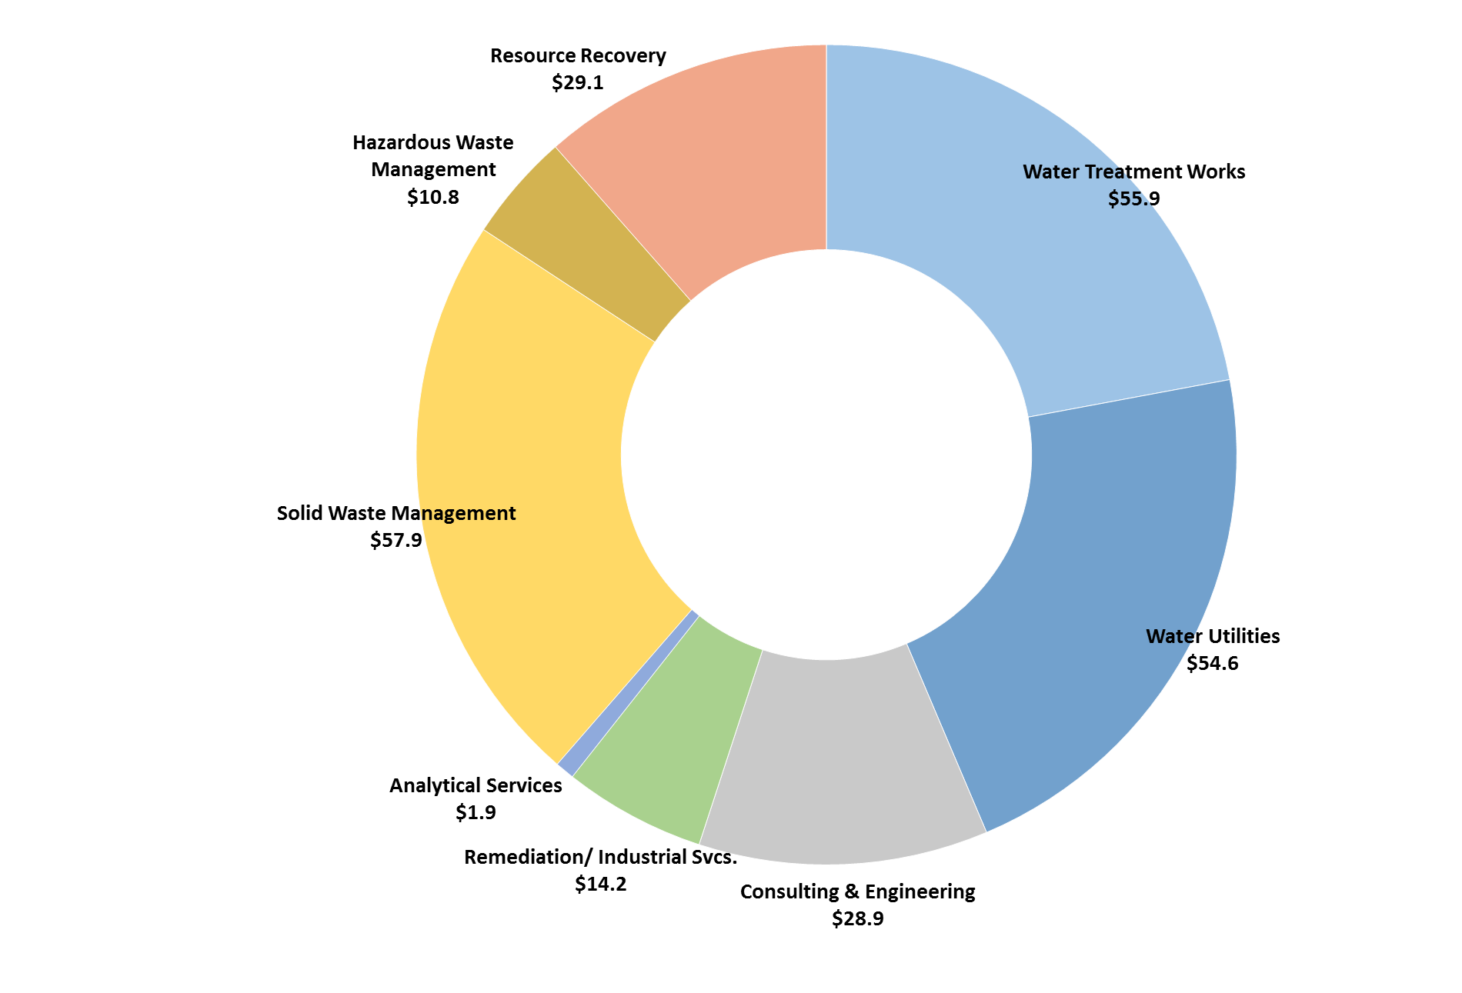
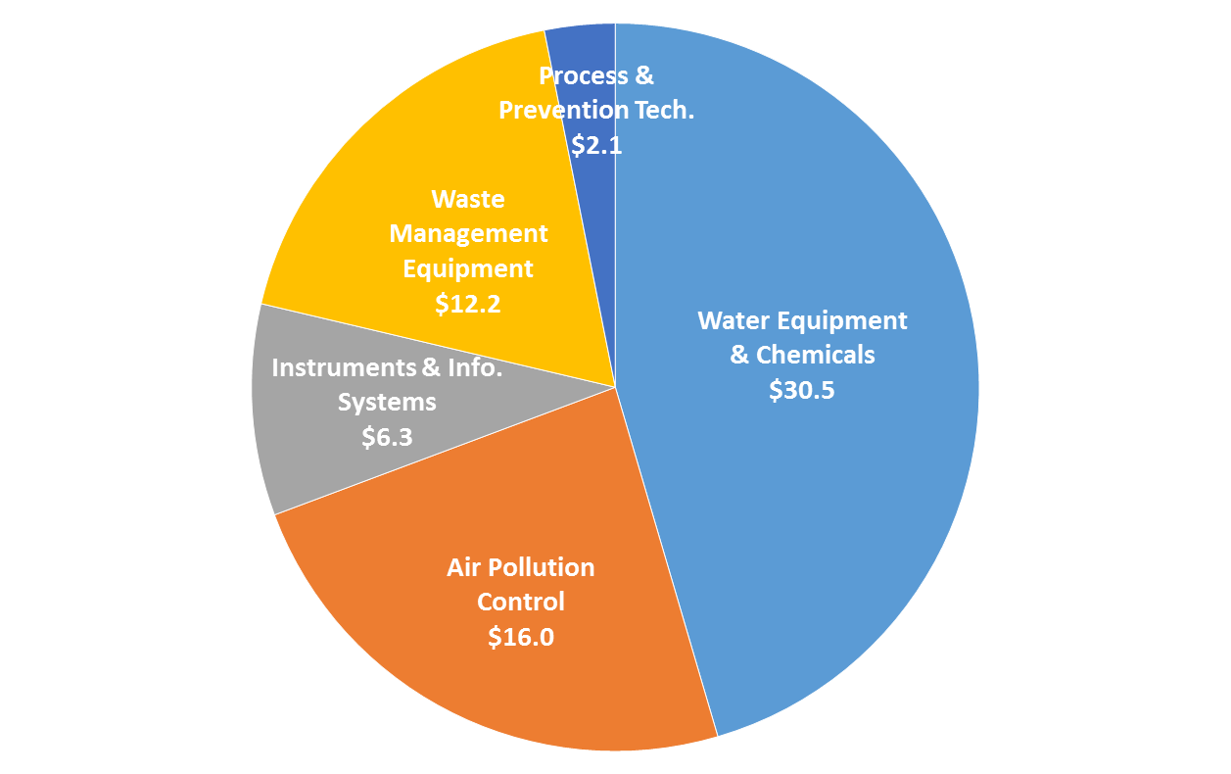
U.S. ET Manufacturing and Services Industry $320.4 Billion
Manufacturing:
Services:
Manufacturing
$67.1
Services
$253.3
Total
$320.4 Billion
Notes:
Global Teams: Communities of Interest around Areas of Expertise
• Our Global Teams are communities of International Trade Administration and U.S. Commercial Service trade professionals, built to meet a continuously evolving demand for specialized expertise. The teams serve exporters with innovative solutions and targeted information to meet their demand for relevant, timely, industry- and country-specific intelligence.

Slide 12

Business Matchmaking
Connect with pre-screened buyers at major U.S. and international trade shows
Exhibit in the U.S. Pavilions at international trade shows
Attend our Discover Global Markets and Trade Winds business forums for networking and one-on-ones with U.S. commercial diplomats
Notes:
Connect with the right partners and prospects.
• Use our International Buyer Program to meet with pre-screened buyers at major U.S. trade shows.
• Exhibit in the U.S. Pavilion at our Certified Trade Fairs or let us distributeyour literature at global trade shows.
• Attend our Discover Global Markets business forums for industry and market insights, one-on-one meetings with visiting commercial officers and buyers, and network with exporters, industry leaders, and government officials.
• Participate in a Trade Winds event—a similar format to Discover Global Markets, but held in a different market each year.

Slide 13

Market Intelligence
The latest market information, prepared by U.S. Commercial Service staff stationed within each market
Customized market research—prepared just for you
Background reports and other information about prospective business partners
Online resources
Notes:
Target the best trade opportunities.
• Country Commercial Guides.
— Leverage reports, prepared annually by U.S. Embassy staff, containing information on the business and economic situation of foreign countries and the political climate as it affects U.S. business and investments.
• Customized Market Research.
— Get specific answers to your specific international business questions.
• Key market research resources:
— trade.gov/fta
— trade.gov/topmarkets
— export.gov/ccg
• Background Reports.
— Learn about potential partners from our trade professionals working in your target markets.
— Get detailed credit reports covering sales, profit figures, potential, liabilities, and other financial information.
• Trade Data and Analysis.
— Obtain the latest annual and quarterly trade data by country, state, commodity, and year.
— Find industry-specific trade data and analysis.

Slide 14

Trade Counseling
Information and advice
Planning, strategy, and solutions
Legal and regulatory issues
Licensing and standards
Intellectual property
Notes:
Get the information and advice you need to succeed:
• Planning and Strategy.
— Create a comprehensive international business plan for entry or expansion into targeted markets.
• Legal and Regulatory Issues.
— Determine export licensing needs for shipping products.
— Understand and comply with global product standards, certification requirements, electricity regulations, and packaging laws.
— Avoid intellectual property issues and legal disputes.
• Documentation and Product Requirements.
— What export documents you need, including information filing, invoices, packing lists, and certificates of origin.
— Learn about tariff rates and import fees; how Free Trade Agreements benefit you.
• Trade Problems.
— Get assistance with customs-related issues.
— Obtain support if your company’s exports or foreign bids are adversely affected by a trade barrier.
— Limit the risk of non-payment and receive assistance if problems arise.

Slide 15

Commercial Diplomacy
Government-to-government support
Overcome unfair or illegal international actions
Coordinate between multiple U.S. government agencies
Work with U.S. Embassies and Consulates to create the best international strategies

Slide 16

  Trade Shows and Business Forums
Discover Global Markets and Trade Winds
Private and public trade events around the world
Other, smaller local/regional industry events

Slide 17
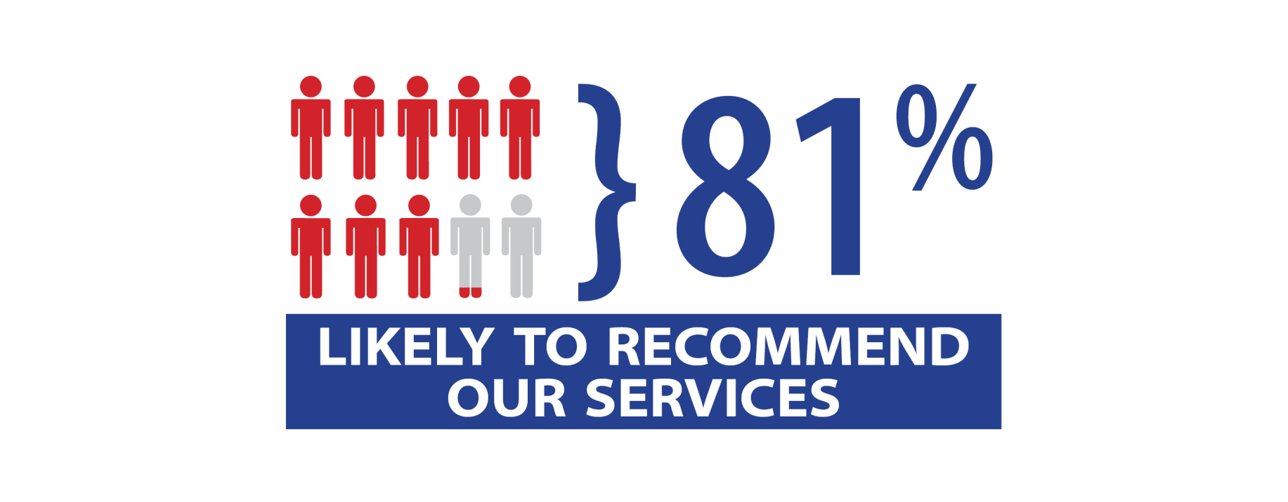
How do our Clients Feel About Us?
The U.S. Commercial Service is among the highest rated organizations, public or private, in terms of customer satisfaction.
Notes:
Percentages reflect 9s/10s
Overall Sat = 9.10 mean
Timeliness = 8.73 mean
Subject Matter Knowledge = 8.67
Ability to Meet Objectives = 8.43

Slide 18
What Clients Love About Us
“…my go-to resource if I have export questions.”
“Friendly and easy to work with.”
“…super helpful and extremely willing to help [accomplish] what I need to do…”
“You care that I will get what I need to succeed.”
“[They] reach out to companies that I could not be aware of... and check their capabilities to represent us.”
“Extensive, good-quality network of country specialists…”
“…overcomes the fear of doing business overseas.”
“…FANTASTIC… responsive, knowledgeable, and go beyond the call [of duty] to assist us with any need, large or small.”
Notes:
“This is my go to resource if I have export questions.”
“Friendly and easy to work with”
“Everyone I have spoken to with both here in America and overseas has been super helpful and extremely willing to help me get accomplished what I need to do. Their support has been outstanding.”
“You care that I will get what I need to succeed.”
“Extensive good quality network of country specialists to work with”
“The ability to reach out to companies that I could not be aware of their existence, and check their capabilities to represent us. And naturally the dedication and professional handling my needs.”
“The professional assistance and attitude along with follow up that overcomes the fear of doing business overseas.”
“The personnel are FANTASTIC […] responsive, knowledgeable, and go beyond the call to assist us with any need, large or small.”

Slide 19

Contact us today to connect with a world of opportunity.
Jorge Arce
Mobile: 904-477-9485
Office: 904-232-1270
Jorge.Arce@trade.gov
http://export.gov/usoffices

