Slide 1
US Construction Spending, Labor and Materials Outlook
WWEMA Washington Meeting
March 22, 2017
Ken Simonson
Chief Economist, AGC of America
simonsonk@agc.org

Slide 2
Construction spending & employment, 2006-2017
Total spending, Feb. ‘06 (peak)-Jan. ‘17
billion $, seasonally adjusted annual rate (SAAR)
Total employment, Apr. ’06 (peak)-Jan. ‘17
thousands, seasonally adjusted
$1.21 trillion
$1.18 trillion
(2% below peak)
7.7 million
6.7 million
Total
Total
(13% below peak)
Private Residential
Nonresidential (9% below peak)
Private nonresidential
Residential (19% below peak)
Public
January 2016-January 2017: total 3%
private res. 6%, private nonres. 9%, public -9%
January 2016-January 2017: total 1.5%
residential 4%, nonresidential 0%

Slide 3
Policy possibilities & uncertainties affecting construction
Infrastructure: How much? How soon? What types? Funding source?
Immigration: Impact on new & current workers? Wall construction?
Trade: Higher materials costs? Shortages? Less or more factory const.?
Regulatory relief: Which ones? How soon?
Health care rewrite: Timing? Impact on demand for hospital const.?
Fiscal: Lower taxes? For whom? Bigger deficits? Implications for construction demand, labor supply?
Monetary: Higher interest rates? Impact on housing, state/local bonds?
Source: Author

Slide 4
Nonresidential segments: 2014-16 change, 2017 forecast
 |  | 2015 vs. 2014 |  | 2016 vs. 2015 |  |  | 2017 forecast
Nonresidential total (public+private) |  | 7 | % | 4 | % |  |  | 2-6%
 | Power (incl. oil & gas field structures, pipelines) |  | -16 | 4 |  |  |  | 5-10
 | Highway and street | 6 |  | 1 |  |  |  | 2-5
 | Educational | 5 |  | 6 |  |  |  | 3-7
 | Manufacturing | 33 |  |  | -4 |  |  | <0
 | Commercial (retail, warehouse, farm) | 6 |  | 11 |  |  |  | 0-5
 | Office | 18 |  | 25 |  |  |  | 8-13
 | Transportation | 8 |  |  | -6 |  |  | 0-5
 | Health care | 5 |  | 2 |  |  |  | 0-5
 | Lodging | 30 |  | 25 |  |  |  | ~0
 | Sewage & waste disposal | 5 |  |  | -9
 | Water supply |  | -2 |  | -9
Source: U.S. Census Bureau construction spending report; Author’s forecast

Slide 5
Construction spending: public works annual total, 2008-13; monthly, SAAR, 1/14-1/17; billion $
Highways (99.7% public in 2016)
Sewage/waste (99% public)
Jan. '16-Jan. '17 change: -10%
Jan. '16-Jan. '17 change: -28%
Transportation facilities (71% public)
Water supply (99% public)
public
private
Jan. '16-Jan. '17 change: -12% (private -11%; public -12%)
Jan. '16-Jan. '17 change: -11%
Source: U.S. Census Bureau construction spending report

Slide 6
Key points: roads, transportation, sewer/water
Highway funds benefit from more travel, hence fuel purchases; gradual pick-up in state funding & P3s; higher federal funding unlikely before ‘18
Railroads slashing investment; pickup in airport projects but no increase likely in port, transit construction funding
Eastern & Midwestern cities under orders to make long-term upgrades to sewer systems that should keep a floor on spending; water utilities hurt by drought, conservation but may get money for lead abatement
Source: Author

Slide 7
Construction spending: industrial, heavy annual total, 2008-13; monthly, SAAR, 1/14-1/17; billion $
Power (93% private in 2016)
Manufacturing (99% private)
Electric
Other
Oil &
Gas
Chemical
Jan. '16-Jan. '17 change: 2% (oil & gas -17%; electric 8%)
Jan. '16-Jan. '17 change: -7% (chemical 4%; other -16%)
Amusement & recreation (55% private)
Communication (99.6% private)
Public
Private
Jan. '16-Jan. '17 change: 10% (private 18%; public 1%)
Jan. '16-Jan. '17 change: -2%
Source: U.S. Census Bureau construction spending report

Slide 8
Key points: power, manufacturing, recreation
Solar, wind power are growing again; expect more gas-fired plants, natural gas pipelines into ‘18
Mfg decline led by completion or delay of chemical plants (fertilizer, ethane crackers, petrochemicals, LNG) and transportation equipment (cars, trucks, jets, railcars); recovery in ‘18 depends on policy impacts
Amusement & recreation spending is very “lumpy”—a few big stadiums at irregular intervals; but funding for local, state, federal parks keeps eroding
Source: Author

Slide 9
Construction spending: education, health care annual total, 2008-13; monthly, SAAR, 1/14-1/17; billion $
Education: state/local K-12, S/L higher; private
Health care: (private hospital, S/L hospital, other)
Total (77% public)
Total (80% private)
Private hospital
S/L
preK-12
S/L
higher ed
Other
Private
S/L hospital
Jan. '16-Jan. '17 change: 5% (state/local preK-12 9%; state/local higher ed -9%; private 16%)
Jan. '16-Jan. '17 change: 7% (private hospital 9%; S/L hospital -20%; other: special care, med. office, federal 5%)
Source: U.S. Census Bureau construction spending report

Slide 10
Key points: education & health care
Bond issues passed in 2014-16 should boost preK-12 projects in 2017 and 2018
Higher-ed enrollment declined 21% from 2011 to 2016, so colleges need fewer dorms & classrooms; apts. (multifamily) replacing dorms (educational construction)
Hospitals face uncertainty about utilization and reimbursement rates if Affordable Care Act is repealed/modified/replaced; also, more competition from standalone urgent care, outpatient surgery, clinics in stores
Source: Author

Slide 11
Construction spending: developer-financed annual total, 2008-13; monthly, SAAR, 1/14-1/17; billion $
Retail (private)
Office (89% private in 2016)
Total
Private
Public
Jan. '16-Jan. '17 change: 7%
Jan. '16-Jan. '17 change: 29% (private 34%; public -5%)
Warehouse (private)
Lodging (private)
Jan. '16-Jan. '17 change: 25%
Jan. '16-Jan. '17 change: 23%
Source: U.S. Census Bureau construction spending report

Slide 12
Key points: retail, warehouse, office, hotel, data centers
Retail now tied to mixed-use buildings & renovations, not standalone stores or shopping centers
Warehouse market still benefiting from e-commerce; more local than huge regional distribution centers likely in future
Record employment each month but office space per employee keeps shrinking; more urban & renovation work than suburban office parks
Hotel construction likely to drop as revenue per available room slows
Data centers remain a strong niche but no daa available on how strong
Source: Author

Slide 13
Private residential spending: MF continues to outpace SF
seasonally adjusted annual rate (SAAR): Jan. 2011 ($238 B)-Jan. 2017 ($476 B)
Multifamily (MF)
(Jan. ‘17: $64 B)
Single-family (SF)
(Jan. ‘17: $254 B)
Improvements
(Jan. ‘17: $159 B)
12-month % change: Jan. 2011 (-5.3%)-Jan. 2017 (3.7%)
Improvements: 10.8%
Multifamily: 9.0%
Total: 5.9%
Single-family: 2.3%
Source: U.S. Census Bureau construction spending reports

Slide 14
Private residential spending--2016: 5%; 2017 forecast: 5-10%
SF: 4% in 2016, 6-11% in 2017; ongoing job gains add to demand; but student debt and other credit impairments, limited supply will limit growth
MF: 16% in 2016, 5-10% in 2017; growth slowing but should last till 2018
occupancy rates, rents have leveled off or dipped in some markets
millennials are staying longer in cities, denser suburbs where MF construction is bigger share of market than in outer suburbs
nearly all MF construction is rental, not condo
Improvements: 4% in 2016, 0-10% in 2017; Census data is not reliable and shows only a loose relationship to SF spending
Source: Author

Slide 15
Population change by state, July 2015-July 2016 (U.S.: 0.70%)
decrease
0-0.49%
0.5-0.99%
1.0-1.49%
1.5%+
1.8%
1.8%
1.0%
0.2
%
NH 0.4%
1.7%
0.1%
0.7%
0.2%
0.1%
-0.01%
VT
-0.2%
-0.2%
0.9%
0.7%
2.0%
0.4%
-0.1%
MA 0.4%
2.0%
0.7%
-0.3%
0.1%
1.7%
0.3%
-0.5%
0.02%
0.3%
0.5%
CT -0.2%
RI 0.1%
0.3%
1.7%
0.03%
1.1%
DE 0.8%
NJ 0.2%
0.4%
0.9%
1.6%
0.3%
1.4%
-0.02%
0.2%
1.1%
MD
0.4%
DC
1.6%
AK
0.6%
0.3%
1.8%
HI 0.2%
Source: U.S. Census Bureau

Slide 16
State construction employment change (U.S.: 2.6%) 1/16 to 1/17: 39 states up, 11 + DC down
Over -10%
-5.1% to -10%
-0.1% to -5%
0%
0.1% to 5%
5.1% to 10%
Over 10%
7%
11%
5%
4%
NH 6%
12%
5%
3%
3%
6%
1%
VT
2%
-5%
4%
2%
10%
1%
3%
MA 4%
5%
-0.4%
-1%
2%
2%
3%
-2%
-1%
3%
1%
CT -2%
RI 9%
3%
3%
-1%
4%
DE 1%
NJ 1%
4%
4%
2%
-0.2%
8%
-5%
1%
4%
MD
2%
DC
-8%
-10%
7%
8%
Shading based on unrounded numbers
HI 0%
Source: BLS state and regional employment report

Slide 17
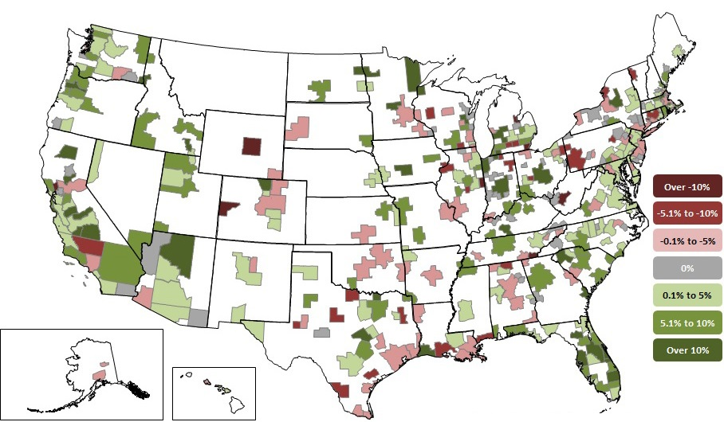
Metro construction employment change 1/16 to 1/17: 219 metros up (61%), 35 unchanged, 104 down (29%)

Slide 18
Hardest positions to fill
Source: AGC Member Survey, August 2016

Slide 19
How contractors are coping with worker shortages

Slide 20
Construction workforce indicators (not seasonally adjusted)
Construction hires, Jan. 2001-Jan. 2017
Job openings, Jan. 2001-Jan. 2017
Unemployment, Jan. 2001-Jan. 2017
Avg. hourly earnings, 12-month % change, Jan. 2001- Jan. 2017
Source: Bureau of Labor Statistics

Slide 21
Producer price indexes for key inputs, 1/11-2/17 (Jan. 2011=100)
Diesel fuel
Steel pipe and tube
Latest 1-mo. change: 1.6%, 12-mo.: 44%
Latest 1-mo. change: 1.6%, 12-mo.: 8%
Copper & brass mill shapes
Aluminum mill shapes
Latest 1-mo. change: 6.5%, 12-mo.: 25%
Latest 1-mo. change: 2.6%, 12-mo.: 8%

Slide 22
Producer price indexes for key inputs, 1/11-2/17 (Jan. 2011=100)
Gypsum products
Paving mixtures
Latest 1-mo. change: 5.3%, 12-mo.: 8%
Latest 1-mo. change: -2.1%, 12-mo.: -2%
Flat glass
Concrete pipe
Latest 1-mo. change: 0.0%, 12-mo.: 2%
Latest 1-mo. change: -0.3%, 12-mo.: 2%

Slide 23
2015-16 summary, 2017 forecast
 |  | 2015 actual | 2016 actual | 2017 forecast
Total spending |  | 11% | 5% |  | 2-7%
 | Private – residential | 17% | 5% |  | 5-10%
 | – nonresidential | 8% | 8% |  | 2-7%
 | Public | 5% | -1% |  | 0-3%
Goods & serv. inputs PPI |  | -2% | 2% |  | 2-4%
Employment cost index |  | 2.2% | 2.2% |  | 3-4%
Source: actuals: Census, BLS; forecasts: Author’s estimates

Slide 24
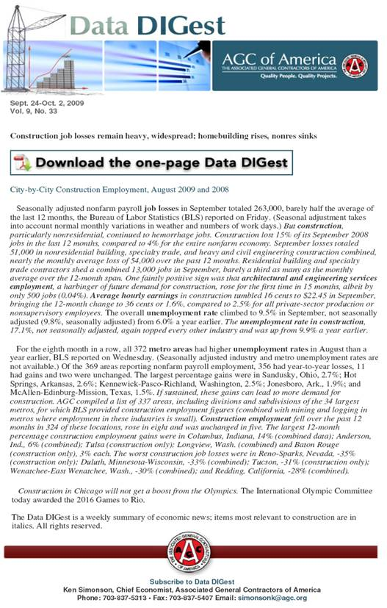
AGC economic resources (email simonsonk@agc.org)
The Data DIGest: weekly 1-page email (subscribe at http://store.agc.org)
monthly press releases: spending; PPI; national, state, metro employment
yearly employment & outlook surveys, state and metro data, fact sheets: www.agc.org/learn/construction-data

