Slide 1
Mark Herring, CRM, CIC, LUTCF MarkH@Heffins.com
Portland, OR Branch
(800) 208-6912

Slide 2
Who am I?
Mark Herring – Certified Risk Manager
32 years Commercial Insurance Experience
27 years specializing in liquid waste business
20 years with Heffernan Insurance Brokers

Slide 3
Why am I here?
Answer your questions!
Inform you of new business concerns
Educate you a little

Slide 4
What am I going to cover?
- Think about your questions -
Cyber Liability Exposures
Wage and hour issues
Employment Practices Liability
Product Liability
How to shop your insurance properly

Slide 5
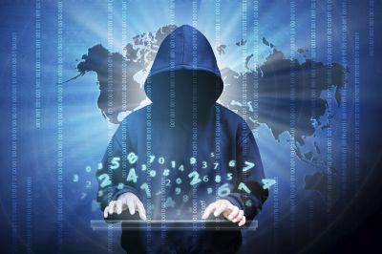
Cyber Liability
Those Business that have been hacked
Those that don’t know they have been hacked
There are two kinds of business regarding Cyber Hacking…

Slide 6
Cyber Liability (continued)
Target Story…
Cyber Sabotage…
Back
Up
Critical

Slide 7
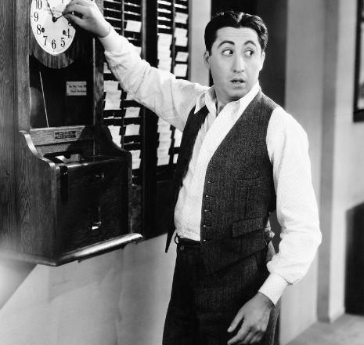
Wage and Hour – Grab your wallet!
Breaks and lunches must be documented
Or they did not happen
Class action law suits
You will likely lose
Story: Knights Pumping

Slide 8
Employment Practices Liability
Employee sues you for:
Sexual Harassment
Discrimination (Race, sex, age, etc.)
Wrongful Termination
Offended

Slide 9
Product Liability
Question & Answer

Slide 10
How to shop your insurance effectively
Ask for loss runs every year!
Control the entire process
Use 2-3 (max) brokers to quote
Set deadline - Do not accept after deadline
Assign insurers to specific brokers

Slide 11
How to shop your insurance effectively (continued)
Info to give brokers
Loss Runs – 4 years minimum – description by you
Narrative about your business, history, safety procedures, operations, futures, claims, etc.
Summary of insurance/policy is best/updates
Anything they ask for

Slide 12
Questions?
Mark Herring, CRM, CIC, LUTCF
(800) 208-6912 MarkH@Heffins.com

