Slide 1
2016 WWEMA FINANCE & CONTRACT ADMINISTRATION COUNCIL May 11-12, 2016 Chicago, Illinois

Slide 2
CMAR: WHAT IT MEANS FOR MANUFACTURERS
Presented By:
Philip E. Beck
Smith, Currie & Hancock LLP
2700 Marquis One Tower
245 Peachtree Center Avenue, N.E.
Atlanta, Georgia 30303-1227
Phone: (404) 582-8028
Email: pebeck@smithcurrie.com

Slide 3
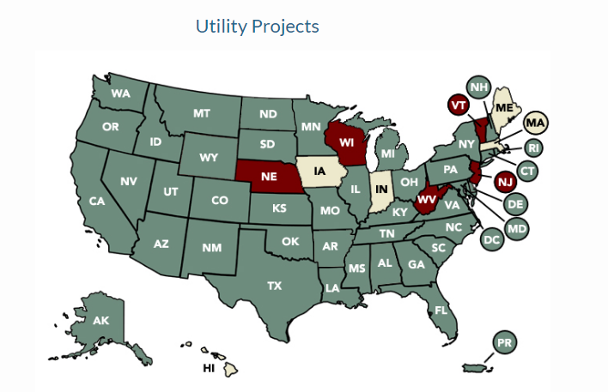
GROWTH OF CM AT-RISK

Slide 4
GENERAL CONTRACTOR VS. CM AT-RISK
Traditional General Contractor
Owner
General Contractor
Architect/Engineer
Subcontractors and Suppliers

Slide 5
GENERAL CONTRACTOR VS. CM AT-RISK
CM At-Risk
Owner
CM At-Risk
Architect/Engineer
Subcontractors and Suppliers

Slide 6
GENERAL CONTRACTOR VS. CM AT-RISK
SO WHAT’S DIFFERENT?

Slide 7
GENERAL CONTRACTOR VS. CM AT-RISK
SIMILARITIES
Contract Structure
Cost, Schedule & Quality Responsibility/Risk
CM/GC Holds Trade Contracts (& thus responsibility for their performance)
DIFFERENCES
Timing of Involvement, Influence & Pricing
Role in Design
Basis of Compensation
May Be Different Firms
Blurred Lines

Slide 8
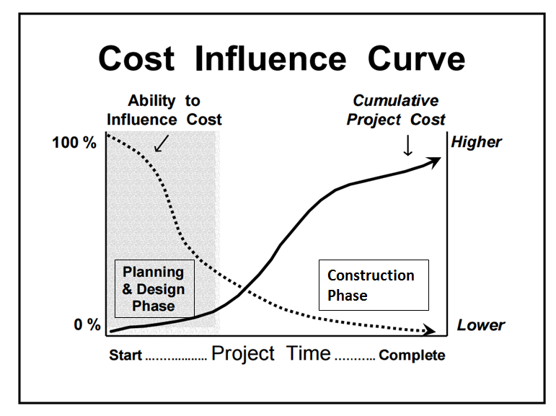
WHY OWNERS INCREASINGLY CHOOSE CM AT-RISK

Slide 9
Impact on equipment manufacturers
Who Selects Equipment?
Flowdown of Risk
Impact of GMP
Identity & Influence of CM’s vs. GC’s
1
2
3
4

Slide 10
Impact on equipment manufacturers: questions for audience
What has your experience been?
Are there geographic differences?
Does CMAR require a different business approach?
Does CMAR change assessment of risk?
1
2
3
4

Slide 11
WHAT SHOULD EQUIPMENT MANUFACTURERS’ RESPONSE TO CMAR BE ?
Stay away at all costs?
Proceed with caution, recognizing the differences & actively managing the altered risks?
Full speed ahead!?

Slide 12
ACTIVELY MANAGING THE RISK OF CMAR
Assess xxxExposure
Limit Exposure
Manage Exposure

Slide 13
THANK YOU FOR YOUR TIME!
Philip E. Beck
(404) 582-8028
pebeck@smithcurrie.com

